Slide 1
Research Overview
Emre Eftelioglu
University of Minnesota – 01/17/2017
Collaboration Objective
Early career researcher, looking to collaborate with domain scientists
Specifically: Context-aware spatial data mining.

Slide 2
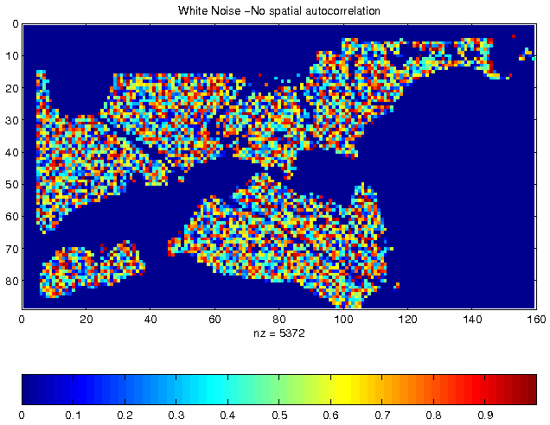
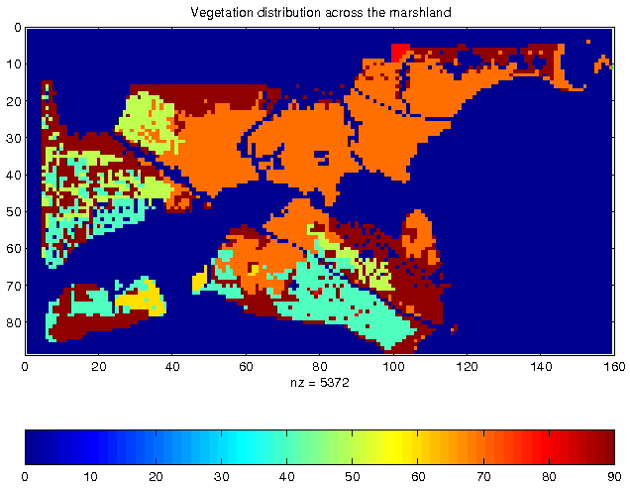
Spatial Autocorrelation
First Law of Geography
All things are related, but nearby things are more related than distant things. [Tobler70]
Spatial autocorrelation
i.i.d. assumption is not valid
Traditional statistics and Machine Learning Techniques do not perform well with spatial data
Violates the laws of physics.
Measures: K-function, Moran’s I, Variogram, …
Independent, Identically Distributed pixel property
Vegetation Durability with SA

Slide 3
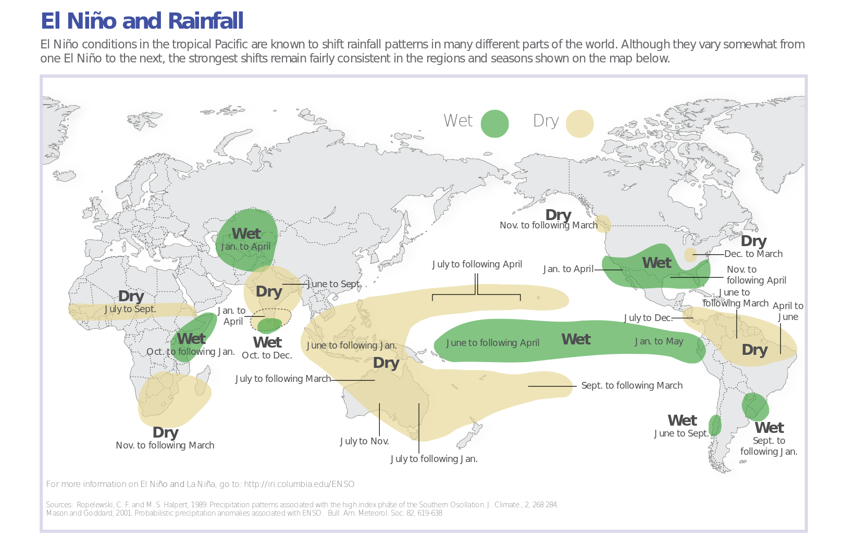
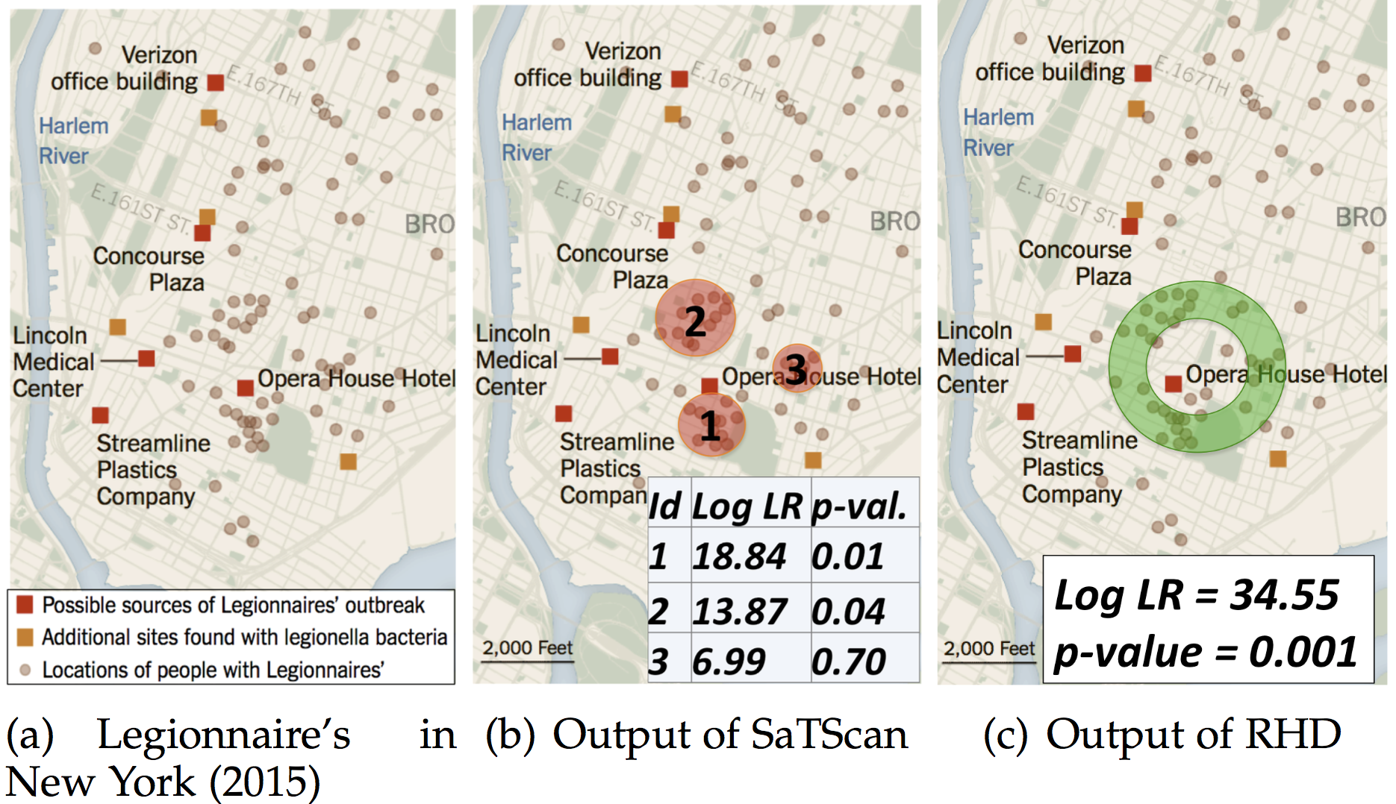
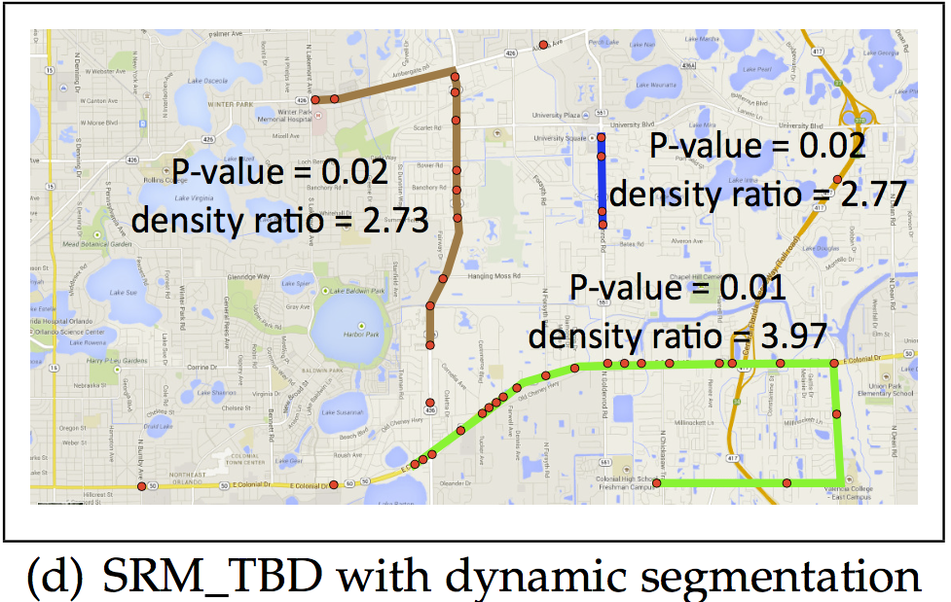
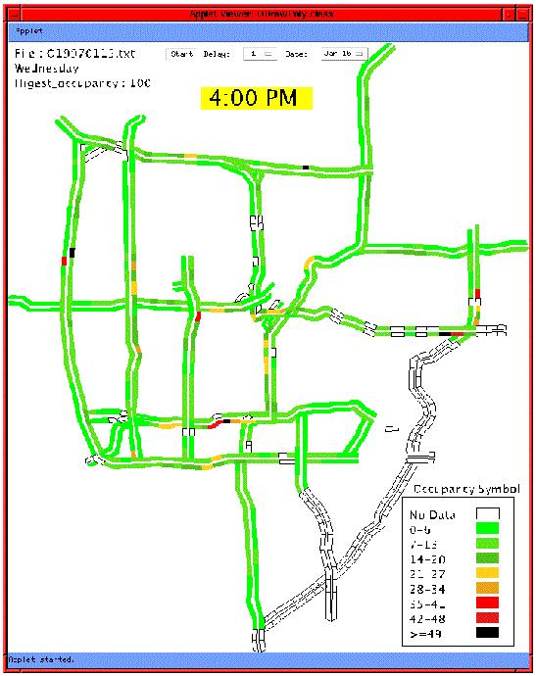
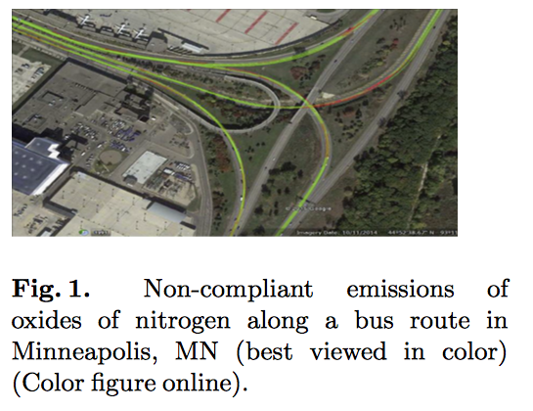
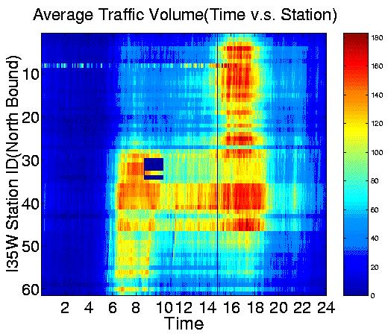
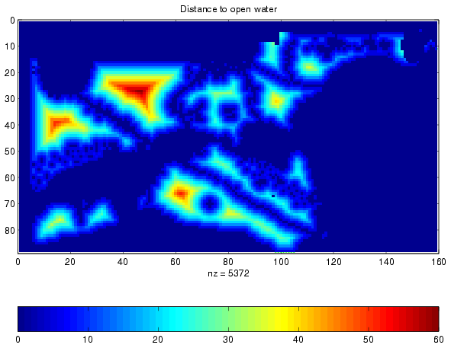
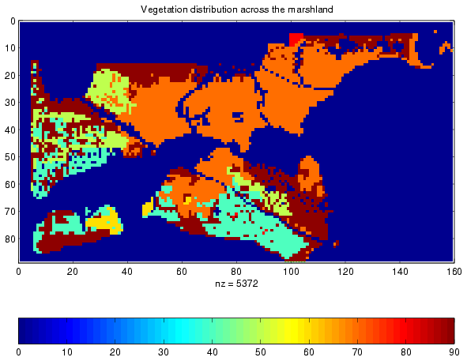
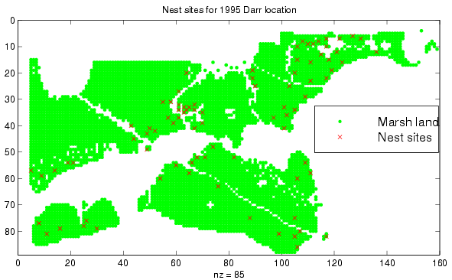
Spatial Pattern Families
Hotspots, Spatial clusters
Spatial outlier, discontinuities
Co-locations, co-occurrences
Location prediction models
Tele-connections
Tele-connections
Hotspots
Spatial Outliers
Co-Location Patterns
Predictions
Nest locations
Distance to open water
Vegetation durability

Slide 4
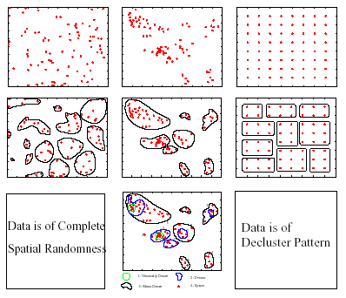
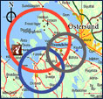
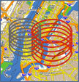

Limitations of Traditional Techniques
Many traditional clustering techniques does not eliminate chance patterns
For example: K-Means finds chance clusters in complete spatial randomness (CSR)
Solution:
Spatial Hotspot Detection
Classical
Clustering
Spatial
Clustering/Hotspot
Detection

Slide 5
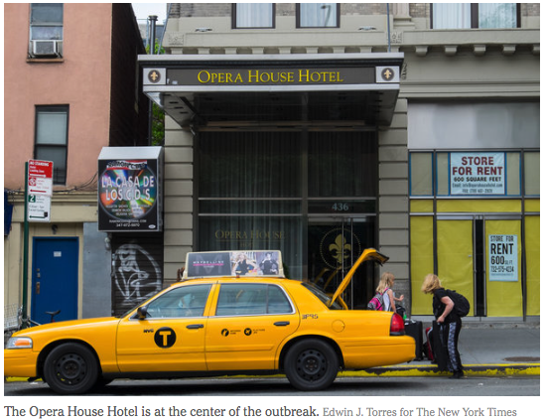
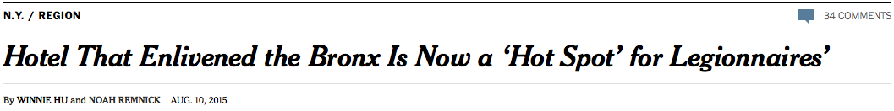
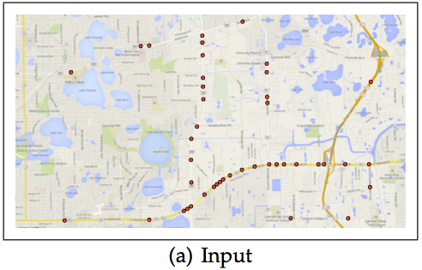
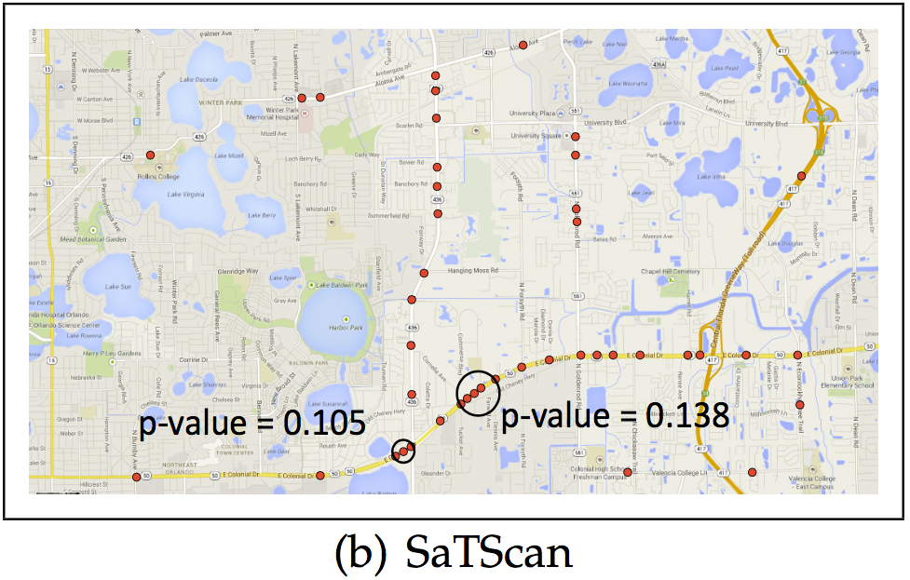
Spatial Context-Aware Hotspots
Spatial Theories
Evasion: No activities near the source e.g. disease – spread latency
Diffusion: Less activities with distance e.g. disease – initial interaction decrease
Circles → Rings
Geographic features e.g., rivers, streams, roads
Hotspots → Hot Geographic Features (e.g. hot routes)
Pedestrian fatality data from Orlando, FL

